Slide 1
Justice is Closest to the
Heart of God
Presentation by Noor
Feast of Tabernacles 012001 (2018)

Slide 2
Justice is Closest…
"Resist evil and evil doers with all your Might. Justice is Closest to the Heart of God!”
Third Declaration
"To present such a system is another main purpose of THOTH. This system is an integral part of the Eternal Divine Path and The Greatest Sign (second seal). This system will bring justice to All. Justice is closest to the Heart of God.“
- O, Son of Man

Slide 3
Justice is Closest…
“Greater than salvation is justice. Justice is salvation.”
- Essays I, Tablet 10, “Justice”

Slide 4
Key Points in Creating Justice
System and society
Judges
Justice over law
Punishment

Slide 5
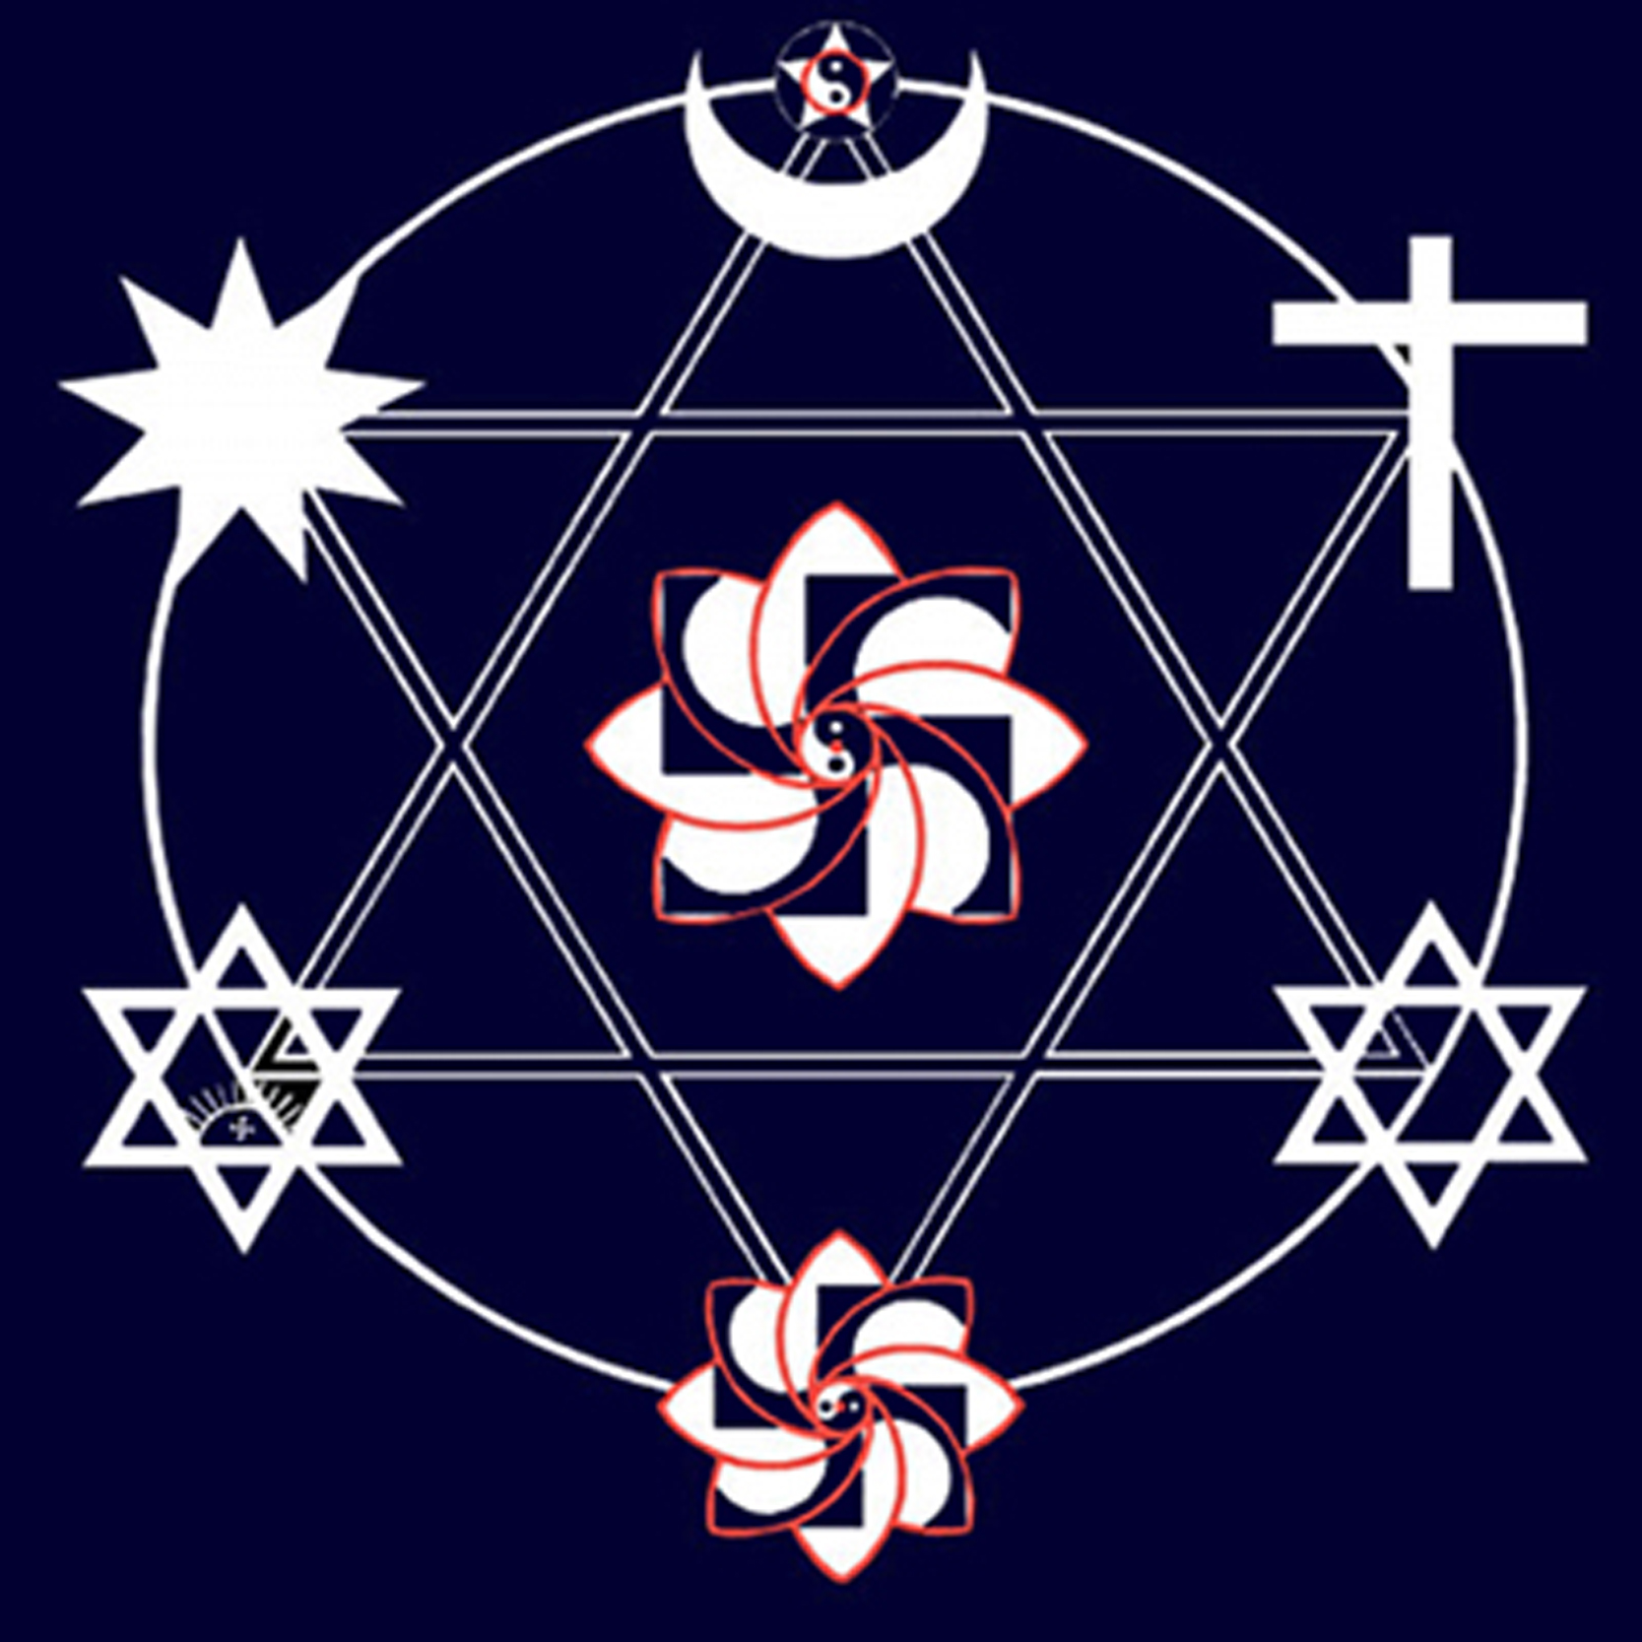
System and Society

Slide 6



The Three Kingdoms of Heaven

Slide 7
Justice Starts with Society
<8>As long as petty criminals are judged and punished when these crimes are done because of inequity in society or from ignorance, and the big criminals who created such an unjust society for their own self-interests are overlooked because of their power or ties to the higher classes in society, or because of following the wrong philosophy in society in whole, justice will not be established. <9>Only in a true society with the greatest possible equity and true philosophy based on God's Laws, with true leaders, can justice be preserved.
- Essays I, Tablet Ten, “Justice”

Slide 8
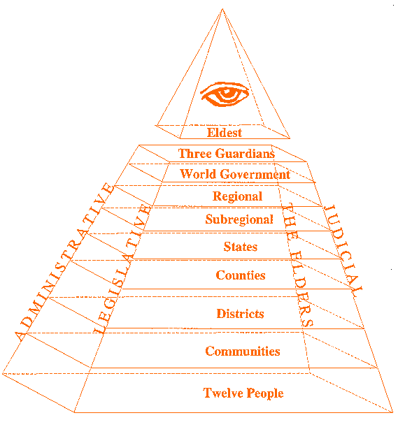
The System

Slide 9
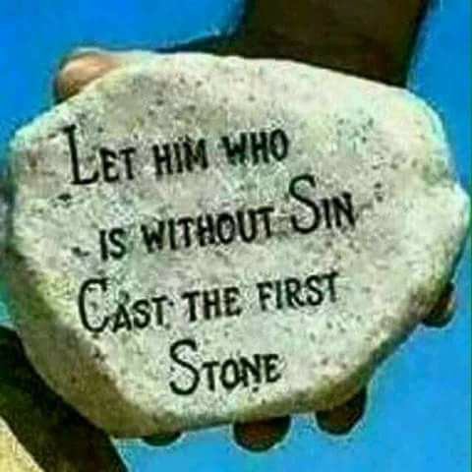
Judges

Slide 10
The System

Slide 11
Justice over Law
<8>That is when there are laws but not justice. <9>Such societies should then stop and ask themselves, "Why do our laws not bring justice?" so they would start to institute common sense in their system and choose those who have this common sense in themselves as judges. <10>Or they should see that their society is degenerating, and eventually will collapse and be replaced.
- Essays II, Tablet 7, “Law or Justice”

Slide 12
Law as Dogma
…the following of the laws becomes so important that their spirit to bring justice is lost. Then they almost become rituals which are to be automatically performed instead of to be understood and changed to bring justice for each situation. In other words, the notion would be law, not justice, so a bureaucracy would be created. But whatever is rigid in this universe and does not do what it was intended to do (its Darma) has no choice but to be broken and replaced by another system which will suit the situation, or one which is flexible enough to change and adapt to the situation.
- Essays III, Introduction

Slide 13
The System

Slide 14
Punishment
…the present prison systems are worse than physical or financial punishments recommended by Divine Laws. The Divine Laws might hurt a person physically or financially, but the prison system destroys the spirit which is much greater than the physical body or financial well-being.
Probably the best approach is to give a person a chance of choosing between a physical and/or financial punishment or imprisonment.
- THOTH, Supplements, God’s Laws vs. Man’s Laws

Slide 15
The System

Slide 16
Final Points
External Symbol of Internal Punishment
What can we do now?
The Prime Directive

