Slide 1
Tantra
Mission of Maitreya, Eternal Divine Path
Presentation by Isaac Emmanuel (Noor)

Slide 2
disclaimer
I am merely a disciple of Maitreya and of the Teachings of the Mission of Maitreya, Eternal Divine Path. I have no right to, and do not, hold myself out as the final authority on the true/ultimate/complete meaning of any part of the Teachings. This presentation is based on my personal understanding of the Teachings and my own experience in applying/implementing them in my life. If God Wills, my perspective may help others. However, only the Source, straight from Maitreya’s Mouth/Hand and unfiltered by any other individual, contains the ultimate Truth: www.maitreya.org

Slide 3
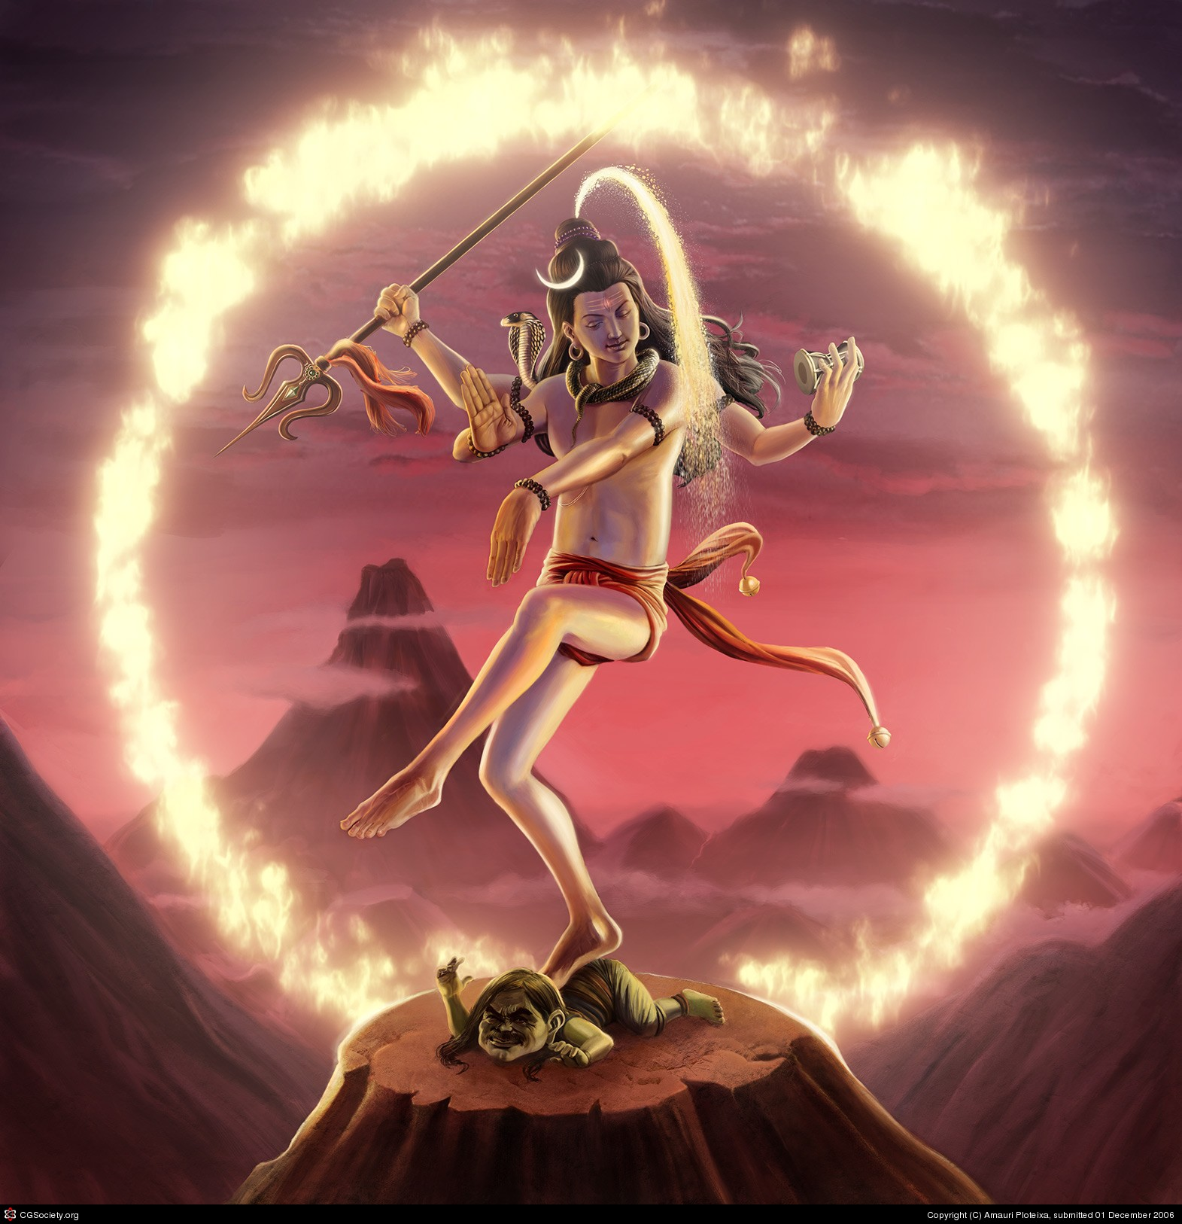
Why Tantra as my topic?

Slide 4
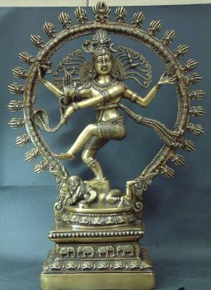
What is tantra?
“Facing your deepest fears and desires”
“To go through any experience but stay objective and detached”
“Going through the emotions/desires/attachments but at the same time staying detached from them”
“Going through the experience and then realizing how empty our attachments and desires are”
“Go to the negativity but you are so focused on God that it doesn’t affect you”

Slide 5
In the beginning…
“God created great compassion for those lost souls. He projected His Light (Christ) into the universe. He desired (willed) that the lost universe might reach Pure Consciousness, ‘Let there be light.’
‘And the Word was made flesh,...’ (John 1:14)
Because The Word was made flesh, he had to go through the same struggle as any other flesh.”
http://www.maitreya.org/FILES/THOTH/Holiest.html/holiest1.htm/Holiest1-4.html

Slide 6
History and the Seven Seals
The Plan of the last 12,000 years
The First Seal, Mystical Paths (awakening of spiritual forces)
Noah
Hinduism
Shiva
The Sixth Seal, Paravipras
Baba (Shrii Shrii Anandamurti)

Slide 7
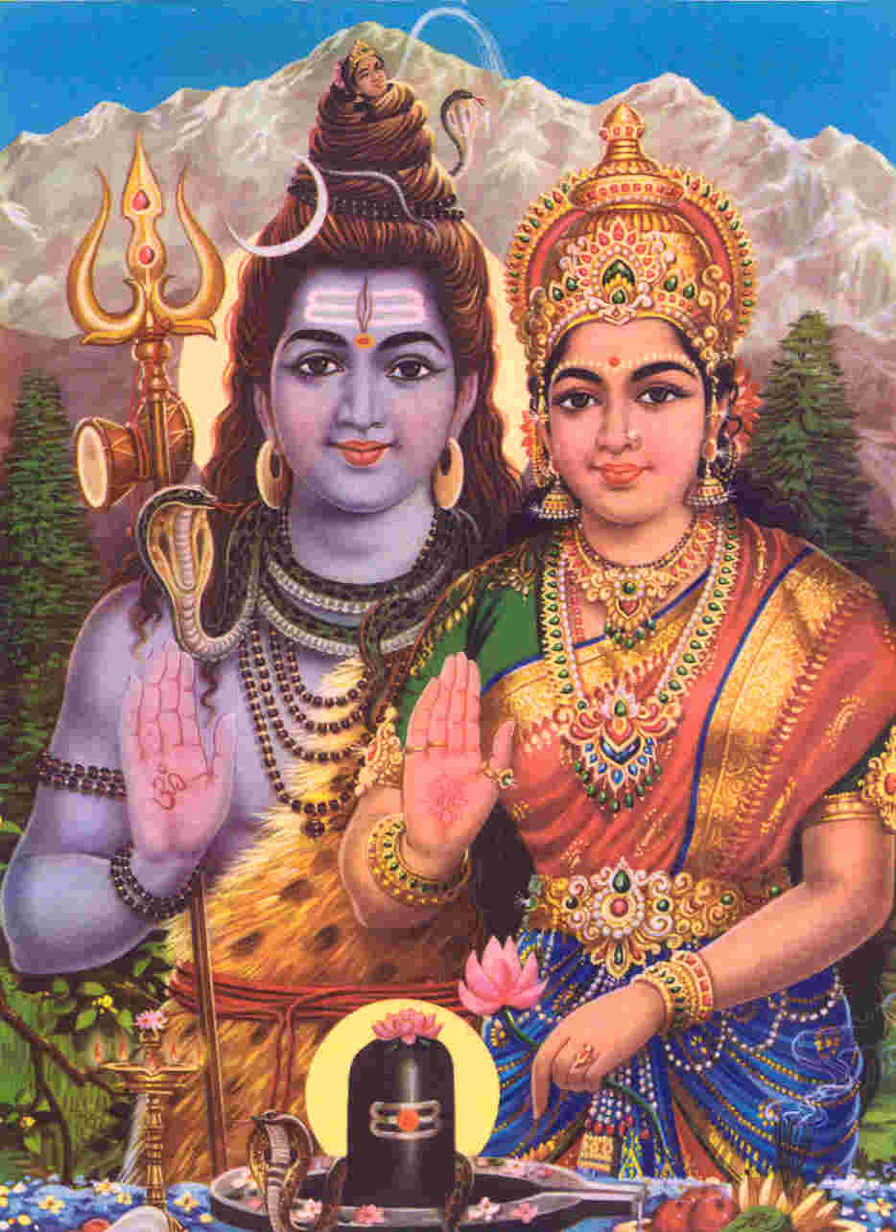
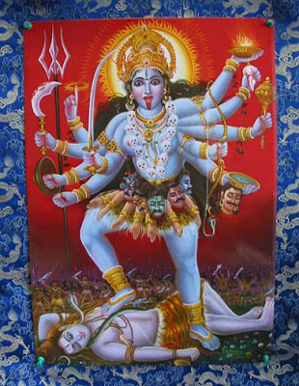
Shiva

Slide 8
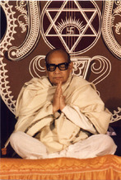
Baba

Slide 9
Yoga and tantra
Yoga: To overcome by discipline/avoidance/denial
Tantra: To overcome by experience/indulgence
However…
BOTH are meditation practices
To lose control in EITHER is to fall/fail
Yoga FIRST
They are more on a spectrum than truly opposites!
YOGA TANTRA

Slide 10
Traditional tantra
You desire it? Go get it!
You fear it? Embrace it!
You hate it? Face it!
…but without losing yourself to it!
(Examples?)

Slide 11
Tantra - Mission Version (“Refined Tantra”)
You want/fear/hate it? Experience it… in your meditation!
Tantra and yoga unified
Power of the mind (visualization practice in meditation process)
Experimentation without external consequences
As usual, the Mission unifies, adds to prior understanding, and takes it to the next level

Slide 12
tantra in mission practices
“Now gently open your eyes, return to the external world, and know that those who meditate on God are in the world but not of it…”
Yogis in the mountains vs. Communities of Light
We are the pioneers…
Other examples?

Slide 13
Tantra in Personal Progress
How to approach a problem? Yoga? Tantra? Refined Tantra?
Default: Yoga! Approach tantra with great caution!
Considerations:
How strong are you?
How risky is the experience (to yourself and others)?
Signs, etc. it is permitted/not permitted?
Can you experience it in meditation (refined tantra)?
Has yoga failed despite your best efforts?

Slide 14
The GOAL…
In Yoga…
In Tantra…
Or in Refined Tantra…
…is to OVERCOME!
YOGA TANTRA
PARAVIPRAHOOD

Slide 15
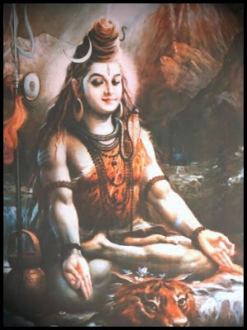
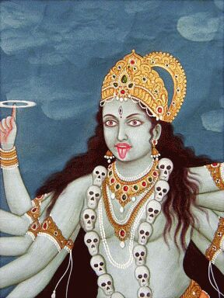
Questions?

