Slide 1
By
Unus
FIndIng Your Place
In
the MIssION
I, Unus, am only sharing the way I study the Teachings of Maitreya with others through this presentation. All should directly go to the source (Mission's Web Site) to study Maitreya's Teachings and learn from Him directly!!!
Feast of Tabernacles 2016

Slide 2


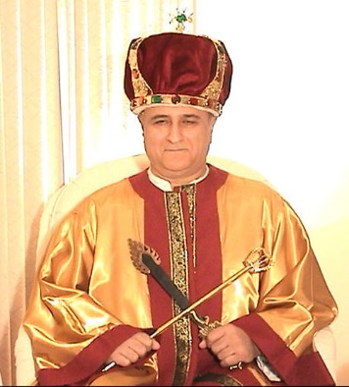
Who is Maitreya?

Slide 3
What is His Mission?
Establishing the Kingdom Of Heaven On Earth
Revealing the Greatest Sign and the Eternal Divine Path
Revealing His Story (History) and God’s Plan and System
Facilitating the Creation of Communities of Light
Notes:
.

Slide 4
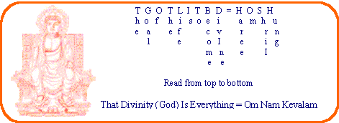
What does He Teach?
Haree Om Shrii Hung
The Goal Of Life Is To Be(come) Divine
Om Nam Kevalam
That Divinity (God) is Everything
Notes:
.

Slide 5

What does the Greatest Sign Reveal?
www.maitreya.org
Notes:
.

Slide 6
Who is He looking for?
The Elects – Paravipras
Notes:
To give an idea about our experience in major projects.

Slide 7
Who is a Paravipra?
A Paravipra is a Person Who Follows the Eternal Divine Path.
A Paravipra is a Person Who Directs All His Energy To Create The Kingdom of Heaven on Earth…
Paravipras Are Those Who Have Reached The Sixth Seal In The Greatest Sign.
Paravipras Are Born Apparently The Same As All Other People Yet They Differ In Spirit.
Paravipras Are Developed Physically, Mentally, And Spiritually!
A Paravipra Is A Person Who Has The Kingdom Of Heaven Within.
Paravipras Are The Implementers Of The Will Of The Lord.
Paravipras Are Fearless.
Paravipras Are The Light Workers.
Paravipras Have The Qualities Of All The Active Classes In Society!
Paravipras Are Themselves Classless.
The Virtue Of Incorruptibility Is The Highest Asset Of A Paravipra.
Paravipras Are The Real Leaders Of Society With No Interests For Selfish Gain Or Desires.

Slide 8
How do we recognize Paravipras?
“You know them (the Elects) by their fruits (Actions).”
MAITREYA

Slide 9
What about the rest of Humanity?
“There are also millions and millions, and billions of people who will hear this word, join the Communities of Light and create the Kingdom Of Heaven On Earth.
Actually those are the ones called meek. They are the poor in spirit. They are the people who will eventually see, “Yes, there is justice. There is righteousness. There are the words of God that come through these Paravipras (Children of Israel).”
MAITREYA

Slide 10
I found the Mission…
WHAT IS NEXT?
Learn More About the Mission
Join the Mission!

Slide 11
What are the Temporary Categories ?
Lights in Darkness - The whole of humanity
Light Seekers - Basic Members
Light Bridges - Contacts
Light Bearers - Full Members (have completely immersed themselves into the Mission)
Light Workers - Those who come close to the Mission Center and become part of its
executive body and/or staff
Light Guides - Leaders and Teachers
Lights in Light - Elders

Slide 12
How does the Leadership work in the Mission?
Maitreya
Three Incarnations
Passing of the Scepter
Round Table
Facilitating Body
COLs – Hierarchy
Kingdom of Heaven On Earth

Slide 13
How do I find my place in the Mission?
You don’t.
It finds you!

Slide 14
All Thanks To God!
Sal-Om!

