Slide 1
God’s Prophets: How Have We Treated Them?
A Lecture for the Mission of Maitreya’s
Feast of Tabernacles 2011
By: Noor
(All credit and glory to GOD Almighty,
and to Maitreya His Son and Prophet)
www.maitreya.org

Slide 2
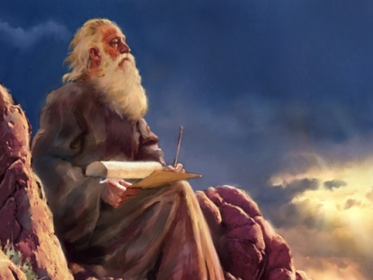
Who is a Prophet of God?
Before 12,000 years ago…
But now…
Sent by God to give a message and/or implement God’s Will on earth
Major Manifestations
Examples?
Minor Prophets
Examples?
They are sent by God to help us! Have we welcomed them and their Messages?

Slide 3
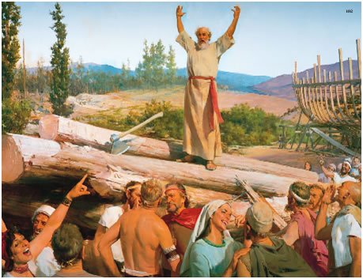
Noah

Slide 4
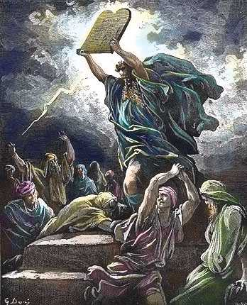
Abraham, Moses, etc.
Abraham
Idols and the hammer (Surah Al-Anbiya - Prophets, 52-70)
Moses
Persecuted at birth
By Pharaoh
By Hebrews
Jacob, Joseph, David, …

Slide 5
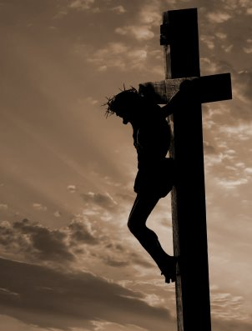
Christ
Persecuted at birth
During Prophethood
Did not fulfill dogmatic expectations
Attacked the leaders and powerful
Ridiculed, persecuted, plotted against, …
Crucified
How many truly accepted him?
Of course, it was Prophesied

Slide 6
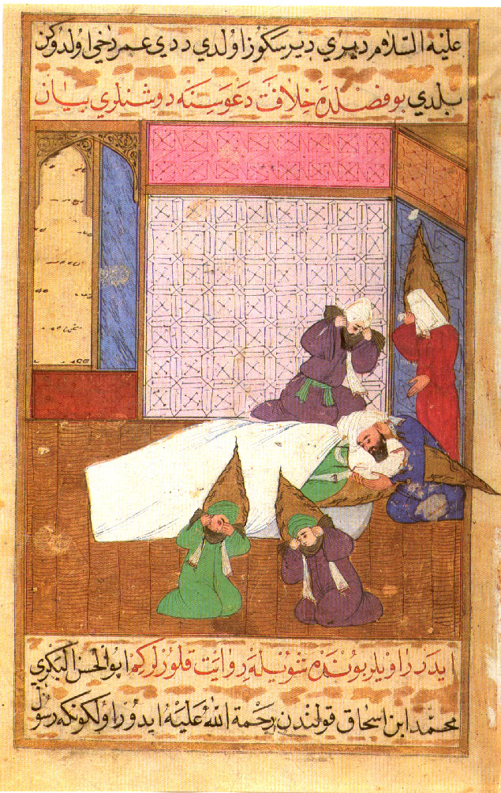
Muhammad
Persecuted by Meccan leaders
Attacked their prosperity and power
Offered him money and power, then ostracized him, then tried to kill him
By previous religions
Did not fulfill dogmatic expectations
Had to go to war
Poisoned

Slide 7
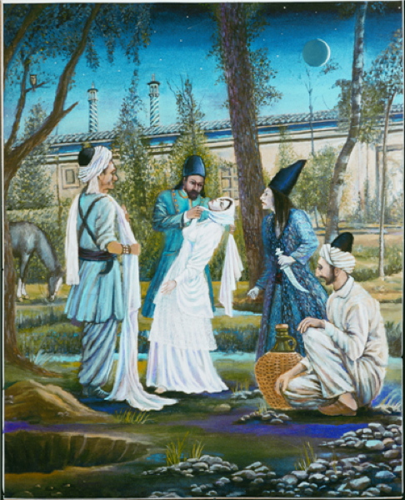
Bab & Baha’u’llah
Bab:
Persecuted by Muslims
Did not fulfill dogmatic expectations
By Government and Religious Leaders
Threatened their power
Killed
Baha’u’llah
Imprisoned
Exiled to Iraq

Slide 8
Baba
Persecuted by traditional Hindu leaders
Did not fulfill dogmatic expectations
Attacked their power and dogmas
By government
Imprisoned for 7 years
Survived poisoning attempt
Ananda Marga labeled as a cult in many countries
Partly because of radical followers

Slide 9
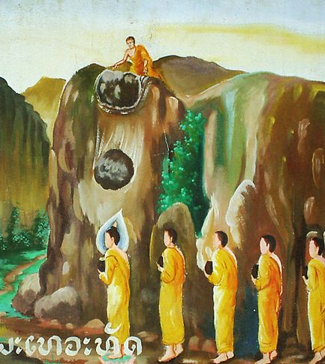
Others
Zoroaster
Minor Old Testament prophets
Mystical Paths
Shiva and Krishna (Hinduism)
Buddha
Native American prophets
…
Joseph Smith (Mormon)
And so on…

Slide 10
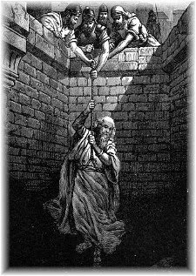
Let’s review…
Accepted or rejected?
Honored or persecuted?
How many did humanity kill or try to kill?
Moses, Joseph, David, Christ, Muhammad, Bab, Baba, Old Testament prophets, Buddha, …
Why were some persecuted less?
Different missions, attacked ego less, never became powerful, etc.

Slide 11
So has humanity rejected EVERY Prophet?
Jonah: The only Prophet humanity ever listened to!

Slide 12
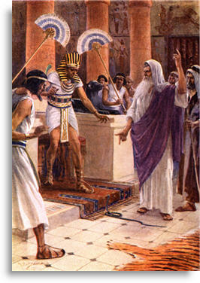
Who rejects the Prophets?
99.99% of the world!
But especially those who love the darkness…
Rich
Powerful
Intellectual spiritualists
Those who are attached to this world!
Those who do not reject, do not necessarily accept
Only a very few truly accept and follow the Prophets each time

Slide 13
Why?
EGO
Attachments, desires, love of the world
Dogmatic expectations
What else?
Prophets tell the Truth, which we do not want to hear!
Source

Slide 14
How do we justify it?
Focus on small problems (faultfinding)
Try to trick the Prophet (God is the Best Trickster!)
Ignore the Proof God has given and ask for our own
False accusations
What else?
Look at yourself honestly…do you do any of these when Maitreya says something that hurts your ego?
Notes:
Christ: Why do your disciples eat on the Sabbath?
Bab: Grammatical errors
Maitreya: Wears glasses
Christ: The woman that had seven husbands; should we pay tribute to Caesar?
Give us a sign!
Muhammad: The 3 questions
Maitreya: Tell me my past, signs and miracles, etc.

Slide 15
Now, Maitreya is HERE…is it any different?
Accused of many things, attacked and called antichrist
Would they have done more, if they could have?
Are Maitreya’s teachings being accepted and followed?
Letter to Humanity

Slide 16
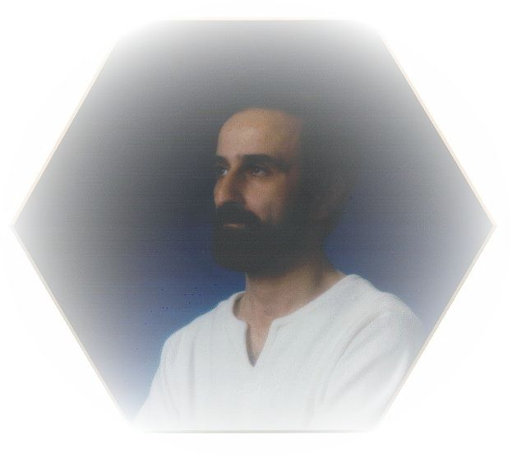
On the other hand…
Protected from physical harm
God prepared the US (set aside in the time of Peleg…) with religious freedom and tolerance
Technology
Thief of the night
Able to complete and Perfect teachings
Probably by the time this Mission really becomes known, Maitreya will no longer be here to be persecuted!
Evolutionary, not revolutionary
God has Promised this time will be different!

Slide 17
Final Thoughts
Why is this important to study and realize?
History (His Story) is a lesson
To understand why our past is full of suffering and destruction, and why it must be God’s Way, not our ways
To better understand ourselves and others (ego)
How are we treating Maitreya in this lifetime?
Maitreya has said more prophets (minor prophets) will come if necessary
Will we reject and persecute them also?
Maitreya Himself will return in 1000 years
Will He be treated the same as in all His previous lifetimes?

Slide 18
All Thanks, Always, To God…
Questions?

