Slide 1
MASTER PLAN FOR PLANET EARTH
(MAP)
Offered by:
MAITREYA
Notes:
MAP is one of two booklets that summarize Maitreya’s teachings. There are two aspects in Maitreya’s teachings: The spiritual aspect and the social aspect. And this booklet, MAP, summarizes the social part of Maitreya’s teachings.

Slide 2
Let us gather together to study the Words of God and his Final Revelation, in the Name of the most Compassionate, the Merciful, the Lord of the universe.
Let us take a moment to bring His Energy among ourselves and be One with Him.
All Thanks To Him and All the Glory is His!
Sal-Om.

Slide 3
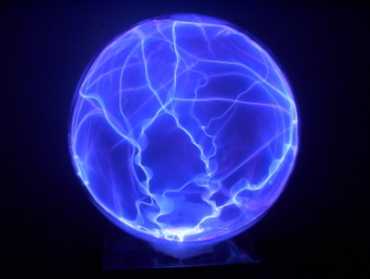
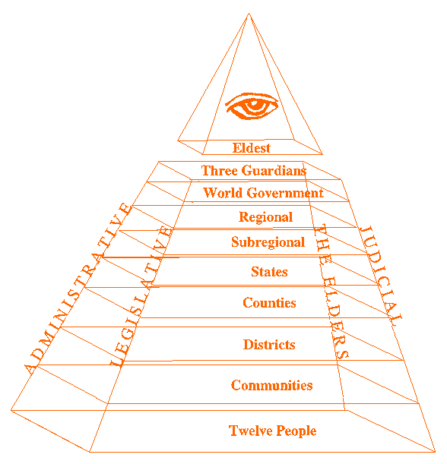
Outline
Maitreya’s Introduction and why the present systems can not work
Offered Regional Government
The World Wide Application of the offered System
Financing the System
Emergence of The Hierarchy
Notes:
1- It’s like an old computer, the operating system is outdated and full of viruses ☺ 2- Selection System, The 4 Pillars and Decision Making 3- Necessary alterations to create a world wide system 4- Two phases: set ups before full manifestation, set ups after full manifestation 5- Practical aspect. Facilitating body as the initial Hierarchy, will emerge from the top to the bottom, and then later on all levels of the Hierarchy will form from the bottom to the top.

Slide 4
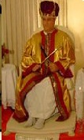
Introduction
“Humanity is again on the threshold of a great evolutionary leap. A new era of a Golden Age is approaching. It is again a time for us to be given another chance to prove that we are worthy to manage our affairs.”
Notes:
In the past, Man forgot he is responsible to create harmony on earth, to utilize his life towards its reason, to recognize the Oneness and interdependence of all, etc.

Slide 5
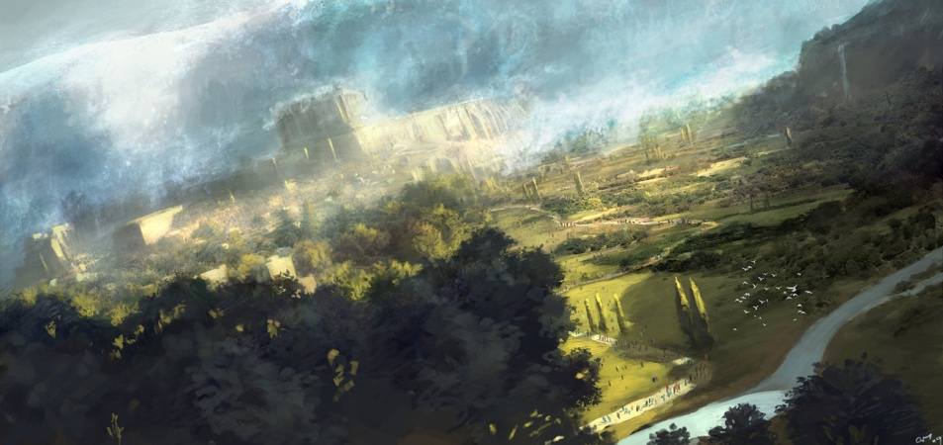
12000 Years Ago
Great Disaster (Flood of Noah)
In the physical and spiritual spheres, man was also altered.
Notes:
A great disaster eradicated all traces of the higher technology of the human at that time, all those who had the knowledge of these technologies were destroyed, or became hidden, spiritual eye was closed and he physically became more bound unto earth. This evolutionary process continued and was completed in full effect six thousand years ago.

Slide 6
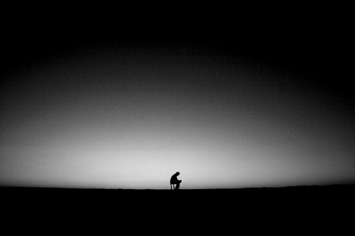
Past 6000 Years
History = His Story
Man was left to himself.
And was directed.
Notes:
In the last six thousand years or so, a period of history was created for man. This was a period of strife, sufferings, and great upheavals. However, whenever it was necessary, an intervention by the Heavenly Hosts directed man to higher levels of understandings. Great events, scientific discoveries, social progress, etc., were directed to this present time

Slide 7
Lessons of the past should be learned!
So that the intended harmonious and just human society can be created on earth.

Slide 8
Why the present systems cannot work?
(1) The process of selecting leaders;
(2) The lack of awareness of humanity that any ideology or approach is valid only in a given time;
(3) The attachment of leaders (and people in general) to a small portion of the earth, a specific culture, group, religion, ideology, etc;
(4) The lack of a body to oversee the system (The Elders);
(5) Lack of the presence of spiritual considerations (putting God out of the system).
Notes:
Before describing the system suggested here, it is appropriate to explain why the present systems cannot work. In general there are five main problems:

Slide 9
(1) The process of selecting leaders
Four conditions are necessary to select the best leaders in current system:
(a) A high level of literacy;
(b) An awareness by the majority of people of their basic rights (socioeconomic awareness);
(c) A willingness on the part of the majority to demand their rights with persistence;
(d) High ethical standards at all levels of society, especially among the leadership.
Notes:
With an exception of the democratic system in which people have a limited control over selection of the leaders, usually people have no control over this process.
The existence of all these is rare. In fact some of them, in normal situations might be found in some societies, but never all of them together. Only the first condition might exist outside times of crisis.

Slide 10
The absence of the four above mentioned prerequisites for selecting the best leaders in the present system results in the emergence of leaders who bring their societies to the brink of crisis.
Notes:
A system should therefore be devised to minimize the effects of the absence of these necessary factors and also to facilitate the emergence of benevolent leaders with the required awareness.

Slide 11
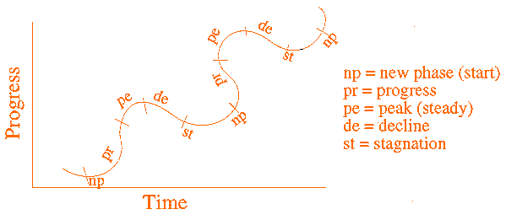
(2) The lack of awareness of humanity that any ideology or approach is valid only in a given time
With clear evidence from history, Maitreya has explained, at length in his teachings, that social progress of humanity is based on a cyclical movement. In each of these cycles one class in society dominates.
Notes:
Every and each of these cycles have similar characteristics. Like the life span of anything in the manifested world, five stages can be recognized. First there is a beginning of a new period (np). The second stage is the time of growth or progress (pr). The third is the time of maturity or peak (pe). This is usually the longest. It is a time of steadiness with little fluctuation. The fourth stage is the start of the period of decline (de), and the fifth stage — the time of stagnation (st) and eventual destruction.

Slide 12
It is in the period of decline and stagnation that the next dominating class will prepare itself with new ideas and alternatives to the old one. Gradually the new ideal replaces the old. This new movement also will go through the same stages in its life span.
Shudras
Ksattriyas
Vipras
Vaeshyas
Notes:
Such periods can be found all through the last six thousand years of human history. The human always resisted change and new ideas. However, in our teachings the ways to avoid such destructive periods are clearly explained.
So far these evolutionary cyclical movements have not been understood by the majority. With this being understood and also the awareness that any ideology, idea, approach, etc., is valid only in a particular period of time, leaders will be more equipped to solve the present and future problems and lead the way to an ever-progressive future.

Slide 13
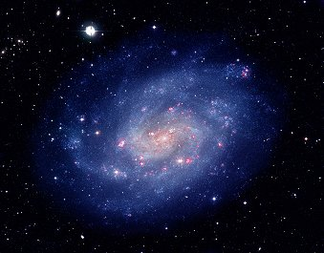
(3) The attachment of leaders (and people in general) to a small portion of the earth, a specific culture, group, religion, ideology, etc.:
Anything which separates human from human will create suffering
Cure
Expansion of the Mind
Notes:
To achieve this goal, a worldwide government and universal point of view is needed. Humanity has to realize that they are so interdependent that they either must learn to share and coexist or they will all perish together. In this regard Maitreya’s teaching is a unifying force.

Slide 14
(4) The lack of a body to oversee the system (The Elders):
No knowledgeable individuals now have as their whole concern the observation and direction of the systems
A body is necessary which would be outside the system but familiar with how it works:
The Elders

Slide 15
(5) Lack of the presence of spiritual considerations (putting God out of the system):
“Separation of church and state" actually should have read,
Dogma
State
“Separation of dogma
and state!”

Slide 16
Two interdependent social components (individuality and collectivity) would be changed simultaneously.
The system presented in Map, together with the rest of Maitreya’s teachings, is intended to eliminate these problems.
This system is for humanity and the New Order of the Ages to come.

Slide 17
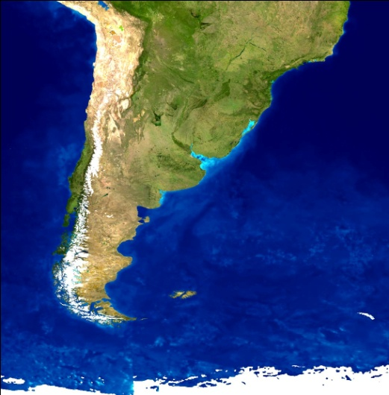
REGIONAL GOVERNMENT
Administrative Body
Judiciary Board (Board of Brahmins)
Legislative Body (House of Elects)
Elders

Slide 18
Region
12 Subregions
12 States
12 Counties
12 Districts
Communities
12 People
Only those people who join such a small group of people can be selected and promoted to the leadership of the collective body.

Slide 19
There would also be six people selected at large by election. These six would not be chosen by the selection process just mentioned, but rather by general vote. These six would join the twelve selected by the system described above. Therefore, the number of the collective body of a region would be eighteen.
12
Selected by the system
6
by general vote
18
The number of leaders in the collective body of a region.

Slide 20
Collective Administrative and Judiciary Bodies of a Region
Representative to the World Collective Body
Region Leader
Direct Reporter
Direct Reporter
Direct Reporter
Direct Reporter
3 Person Group
3 Person Group
3 Person Group
3 Person Group
Notes:
The last twelve leaders would assume direct responsibility for the twelve regions. The regional representative to the world collective body, the leader of the collective body, and the four reporting directly to the leader would closely cooperate with the six people elected at large. The world representative of that region, the leader of the collective body, and the four direct reporters would no longer be available to assume responsibility for the region they were elected from, therefore the six elected leaders would each be given a region to lead. Since these six leaders would not necessarily be familiar with the problems and situations of those regions, the selected person from that region would join them in the responsibility for that region. They would cooperate such that the person who was selected by a region would act as advisor to the person who assumed the responsibility.

Slide 21
The six leaders elected at large would not be able to assume the positions of world representative, leadership of the collective body, or become a direct reporter for the first time they were elected to the collective body. However, they could assume the position of direct reporter if elected twice, and could be regarded as candidates for leader of the collective body or regional representative to the world body if elected three times.
If Elected Twice – Candidate for Direct Reporter
If Elected Three Times – Candidate for Regional Representative or Leader of Collective Body of the Region.

Slide 22
If the leader selected from a region did not agree with the decisions made by the person appointed as a replacement, the matter would be decided by the judgment of the leader of the collective body.
If the problem was between the regional world representative or the leader of the collective body and the leader of their subregion, the matter would be solved by majority vote of the collective body or regional Eldest.
The four reporting directly to the leader of the collective body would not assume leadership of a three-person group including the region from which they have emerged.

Slide 23
After 4 Years
Select
Representative to the World Collective Body
Region Leader
After the selection of these leaders, the rest of the body would return to their regional leadership levels. Then the leaders for the next four years at those levels would be selected, and so on, until all the levels were selected. Because of the dynamics of the system, it should not take a long time.

Slide 24
Legislative Body (House of Elects)
Selected from people known for their virtues and willingness to solve
the problems of their communities, of their regions, and of the world
in general.
The duty of the Senate would be to study social problems carefully
and to consider laws for dealing with them. Spiritual values would
also be regarded in these decisions. The Senate would also have the
power of impeachment of officials in the administrative and judiciary
systems.

Slide 25
Elders
Those who have been elected for two terms as head of the collective
body (administrative body), the judiciary body (Brahmins), and the
legislative body (Senate) would assume the positions of Elders at
those levels. They would be observers of the system. Those people
who were elected to any position at any other level of government for
four successive terms (except the direct reporters, who would require
three terms) would gain the title of Elder at that level.
If Selected 2 Times
Head of a Board
If Selected 3 Times
Direct Reporter
If Selected 4 Times
At Any Other Level

Slide 26
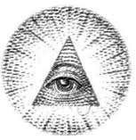
Elders
Legislative
People
Judiciary
Administrative
People
People

Slide 27
Decision Making Process
Study a proposal from the point of view of practicality and justness
Study it from the point of view of spirituality and justness
Legislative
Judiciary
Study the bill from the point of view of practicality and feasibility
Committees
Law
People, Groups, Governmental Bodies
Administrative

Slide 28
Decision Making Process
Law
Legislative
Judiciary
Committees
People, Groups, Governmental Bodies
Administrative

Slide 29
World Wide Government
World Collective Body (administrative),
World Judiciary Body (board of Brahmins),
World Senate,
World Body of Elders.
To create the world administrative and judiciary bodies,
one person from the corresponding boards of each
region would be selected as the representative to the
world body.
Notes:
From those elected by vote, only those who had been selected three times to the regional levels would be considered for election to the world bodies.

Slide 30
From those elected by vote, only those who had been selected three times to the regional levels would be considered for election to the world bodies. In addition, for each body at the world level (administrative and judiciary), there would be seven persons elected by vote. Thus the number of each of these two bodies would be nineteen (twelve from the twelve regions and seven by vote).
12
Selected by the system
7
by general vote
19
The number of leaders in the collective body of a region.

Slide 31
Structure of the World Administrative and Judiciary Bodies
Leader
Direct Reporter
Reporter
Reporter
Direct Reporter
Reporter
Reporter
3 Regional Leaders
3 Regional Leaders
3 Regional Leader
3 Regional Leader

Slide 32
The world legislative body would be elected by vote. Two representatives would be elected from each sub-region (there would be twelve sub-regions in each of the twelve regions).
Therefore the World Senate would contain 2 x 12 x 12 = 288 members, from all over the world (or other arrangements can be devised, such as some number of representatives from states, etc).
A House of Representatives could also be formed in each region and world level. The presence of two houses would bring a greater screening power into the system (but also more bureaucracy).

Slide 33
Financing the System
Two phases:
First, the financial set-ups needed before full manifestation,
Tithes, donations and gifts from these supporters. (10% of a person’s income), it is recommended to give 7% for the support of our vision and use 3% to promote prosperity in the immediate surroundings of your communities — help those who need financial support in your communities or promote our vision in those communities, etc. As the community expands, this amount will increase (as others also will add to it), and you (community) will have greater resources to reach out and expand the Mission, etc.
Second, after it has manifested itself in full.

Slide 34
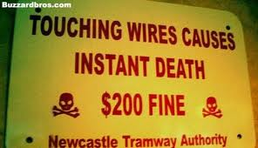
Second, after it has manifested itself in full.
The expenses necessary to be paid for the services (minimum) by the government(s) for the people would be provided by taxes.
Not even death is for free!
The expenses necessary for the judiciary, administrative and Elder bodies will continue to be provided through contributions from the tithes from participants in the communities and others, gifts and donations. However, in this state, if this support is not sufficient for the expenses of these bodies, matching funds from taxes will be added to these resources. These matching funds should not, by any means, exceed 100% of the funds provided from the tithes, gifts, donations, etc.
Notes:
If the money collected from the first two sources (gifts and tithes) was not sufficient for the expenses of these bodies, then from the general taxes, up to 100 percent to match the collected funds from gifts and tithes, could be taken to double the income of these bodies. This matching fund should never exceed the 100 percent limit. This matching system could also be used as an economical tool to inject or withdraw money from the economy in order to control and direct it.

Slide 35
The reason for limiting the matching process is that the judiciary and administrative bodies should be so respected and trusted that people should be willing to join and support them fully through the first two sources of income (gifts and tithes).
Of the money generated at the world level, 10 percent (tithes) would be given to the World Eldest to be used for his expenses and for administrative expenses of the Elder body at the world level. This would also be true at the regional level. 30% to the World Government and the remaining divided between the two bodies (Administrative and Judiciary).
The general public would be taxed for the services they required from the government, and the salaries and financial requirements for maintaining and operating the Senate (and/or the House of Representatives) would be paid by the taxpayers.
The financing of candidates who run for vote-elected office would be achieved half by direct contributions to the candidates and half by matching tax funds from the government. A ceiling could be put on how much a candidate could spend.
Notes:
The financing of candidates who run for vote-elected office would be achieved half by direct contributions to the candidates and half by matching tax funds from the government. A ceiling could be put on how much a candidate could spend.

Slide 36
The other financial arrangements in each community depend upon the people involved.
One way to do this is to identify the collective expenses and finance them through contributions by all in the community. This can include administrative expenses of the community.
Another way can be to surrender some fixed percentage of income to the community for various expenses, or to fix an amount to be paid by each family, etc. This decision is completely up to each individual community, based on their unique situation or desires.
Notes:
Those who would not be participating in a group of twelve people, but who are willing to support this cause and the system, could give at least 7% of their income to be used to finance the system.

Slide 37
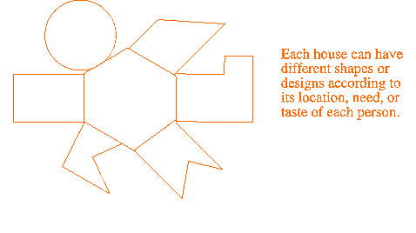
A Recommended Twelve-Base Housing
With this arrangement, the families would be close together and could use the center as a place of love, sharing, and if they wished, worshipping and becoming one, while each family would still have relative privacy.

Slide 38
Emergence of the Hierarchy
The success of The Plan depends upon the response of humanity to its call! The sooner the response, the less suffering; the slower the response, the greater will be the chaos.
Evolution vs. Revolution
There will not be a great friction between evolutionary elements and the old system — in contrast to revolution which is a process which forms from the bottom of the society, and usually replaces the old system by force, which creates a great friction between the two systems.

Slide 39
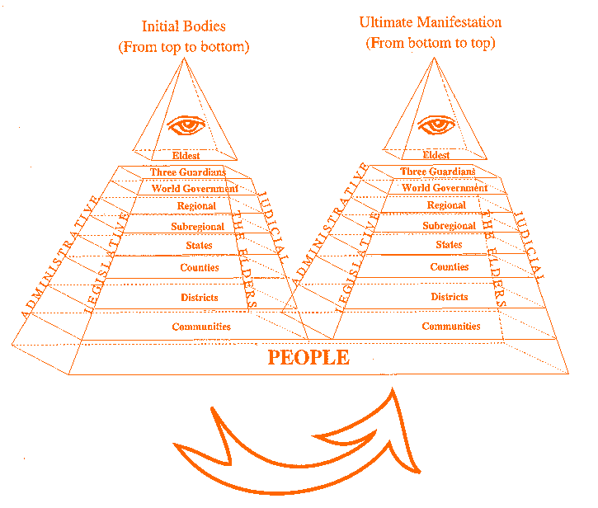
Emergence of the Elders From the Top
Formation of the Hierarchy From the Bottom
Although the formation of the Hierarchy described is to start from the top, in reality it can form spontaneously in all levels. But the ultimate manifestation will be from the bottom to the top.

Slide 40
FINAL POINTS
Subjective Approach with Objective Adjustment
"Subjective approach" is here taken to mean a constant approach toward our goal, or ideal, or perfection. "Objective adjustment" here means to adjust ourselves and our ideal to the situation we are in now. Therefore, "subjective approach with objective adjustment" means to strive ceaselessly toward our goal, ideal, and perfection, yet to be flexible enough to adapt ourselves to the present situation. However, this should never keep us from progressing.

Slide 41
FINAL POINTS
New Hierarchy vs. the Old One
The system above has been revealed to us in this time, because humanity has reached a point where a great evolutionary step is necessary. The old patterns are crumbling and are no longer suitable for our needs and level of consciousness.
Like any evolutionary change, this system will simply replace the old one, while the old one slowly loses its power and all will see the end of its usefulness. As it is explained, in an evolution, changes come gradually, therefore there will not be great friction between evolutionary elements and the old pattern — in contrast to revolution which is a forceful change which usually creates great friction between the two systems. The New Order of The Ages will come in a transitory manner through the wisdom of the Elders.

Slide 42
FINAL POINTS
Progressive Nature of the Universe
The very nature of the universe is progressive — all things are marching toward perfection. It is true of everything, even our system. So if in the future this system can be perfected further, or altered by the progress of humanity to a higher level of consciousness, development could be viewed as an evolution toward perfection.
However, all such developments should be progressive, not counter-evolutionary. The system may be improved on or adjusted. But its base, which is to bring justice, peace, and progress into the universe, should not be sacrificed.

Slide 43
FINAL POINTS
Exceptions to the Rule
The system described, or any other approach to human existence, should not become rigid and exclusive. As the normal distribution in statistics shows, there will always be exceptions.
In fact it is the few positive exceptions to the rule which usually bring about greater change and progress. Therefore no system or arrangement should become so rigid as to destroy or slow down the development and manifestation of these exceptional talents.
The very nature of the universe, in its highest state, is free, happy, and progressive. Anything that opposes this basic nature is not natural; it will create suffering and will eventually be destroyed.

Slide 44
All Thanks To God!
MAP booklet by no means represents the entire vision revealed by Maitreya. In order for this system to work, the whole teaching must be considered. Those who would see His vision and accept it, will assist in bringing the truth to the earth.
It is the visionaries who will lead in the dawn of the new order: "Without vision, the people will perish."
Sal-Om.

